Slide 1



Facebook Login
Android study

Slide 2
EditText

Slide 3
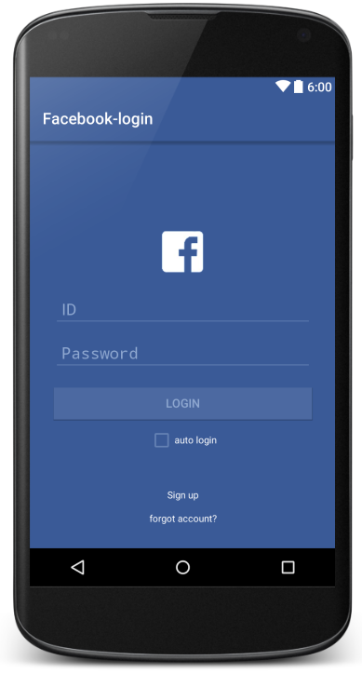
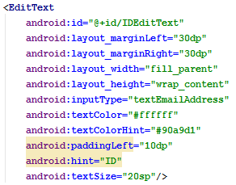

Slide 4
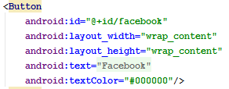

Slide 6
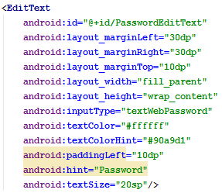

Slide 7
acustom
When you make variable or Activity,
Small letter
Capital letter
myClass

Slide 8
Java & Object

Slide 9
JAVA is
Object Oriented Programming Language
Class
: A variable type to describe properties of something that made by programmer
Object
: A variable which is derived from class
int a;
myClass myObject1;
myClass myObject2;

Slide 10
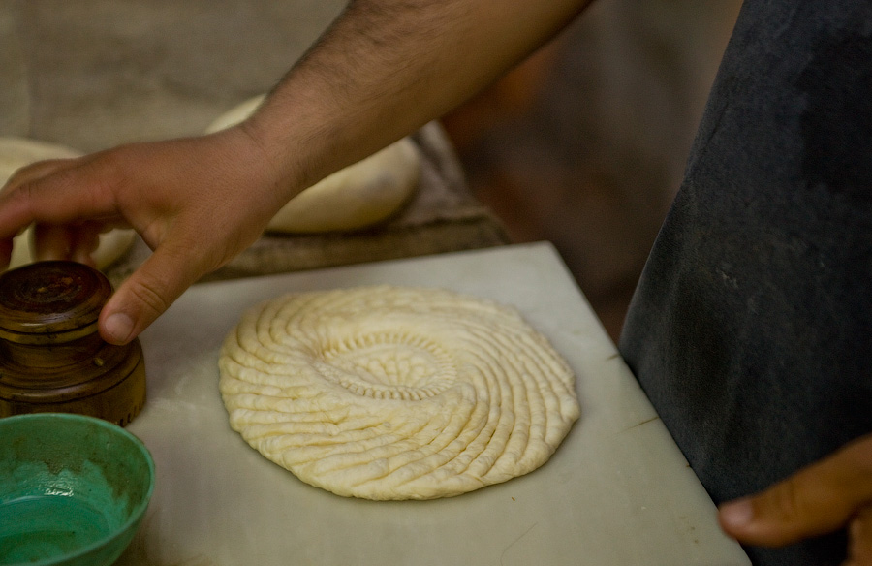
class
object

Slide 11
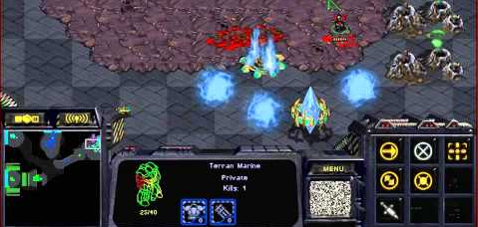
Class Marine
{
int attack ability;
int shield ability;
unsigned int HP;
……
//action function
void attack();
void stop();
void move();
……..
};
Object of Marine class

Slide 12

Marine
int attack ability;
int shield ability;
unsigned int HP;
void attack();
void stop();
void move();
Marine myMarine1;
HP
Attacked!
Marine myMarine2;
HP
myMarine1.stop()

Slide 13
JAVA has
No pointer
But almost all variables act like pointer
who store address of objects.
myClass a;
a.someMethod(); //error!

Slide 14
JAVA has
No pointer
But almost all variables act like pointer
who store address of objects.
myClass a = new myClass();
a.someMethod(); //It works!

Slide 15
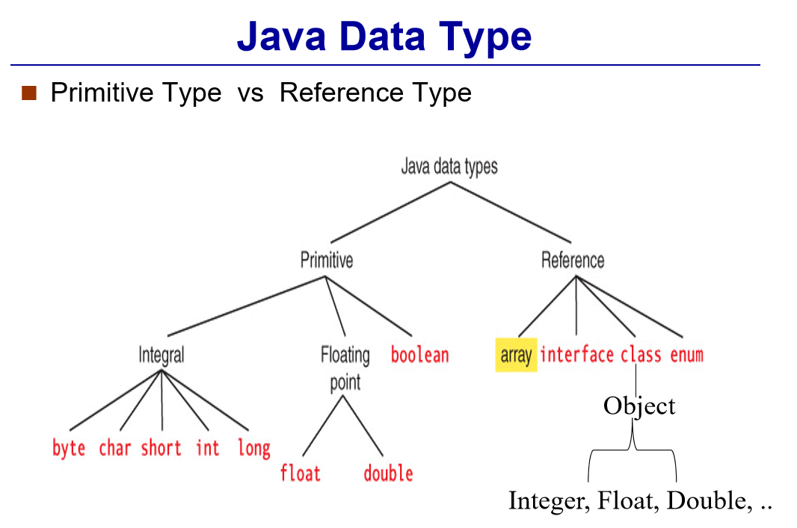

Slide 16
Inheritance

Slide 17

Parent Class
Child Class
Give his method, variables…
Child Class
Parent Class
onCreate
setContentView
findViewById
getSystemService
onResume
onPause
…
onCreate
setContentView
findViewById
getSystemService
onResume
onPause
…

Slide 18
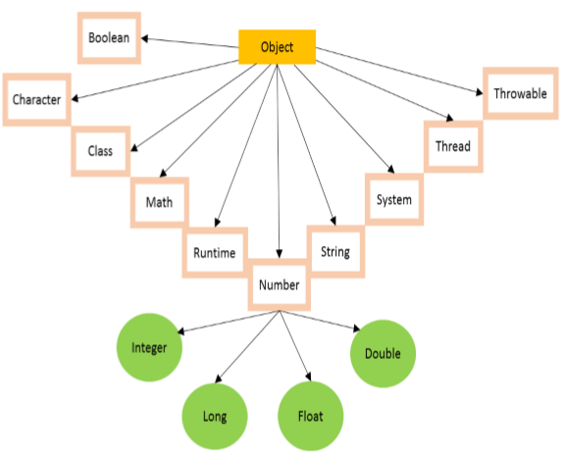
All Java classes are directly or in directly derived from a class named object
toString()
Equals()

Slide 19
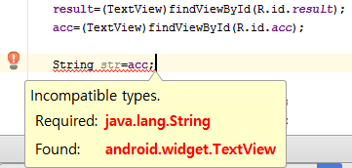

Example of toString()

Slide 20
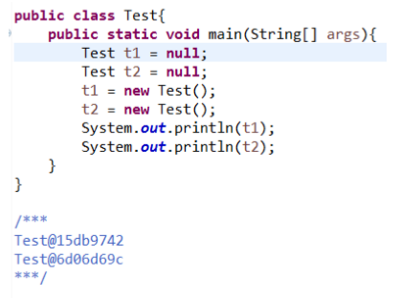
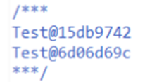
Example of equals()
hash?
Java does not allow that user access to address.
So they made address of “hash”.

Slide 21
Example of equals()
Object1==object2
//It checks whether hash is equal or not
Object1.equals(object2)
//It checks whether hash is equal or not, also
But if the object is String,
then the equals() method is overrided

Slide 22
Override

Slide 23
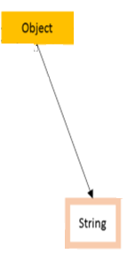
Override
Parent Class : Object
equals()
Child Class : String
@Overriding
equals()
Changing parent class’ method

Slide 24
Overrided equals()
StringObject1==StringObject2
//It checks whether hash is equal or not
StringObject1.equals(StringObject2)
//It checks whether the contents are equal or not

Slide 25
Android Java

Slide 26
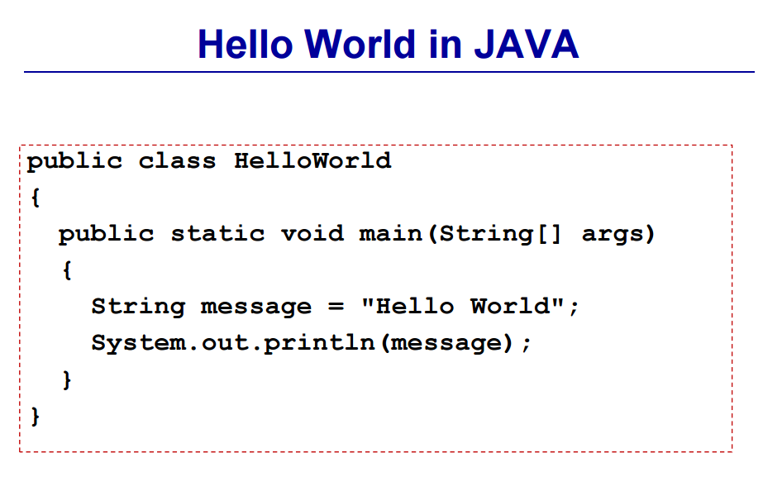
String message
= new String(“Hello World”);
File name and class name should be same
▲public : external class and method can access this class ‘HelloWorld’
String is class. It make object named ‘Message’
▲ Object out invoke method ‘println’ and the parameter is ‘message’
Static: not belong to something. Everything in the class shares that method

Slide 27
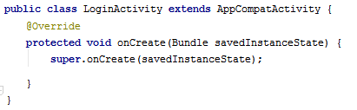
onCreate()
Like main() method in ordinary java

Slide 28
this and super

Slide 29
Constructor
Public class myClass extends parentClass
{
int a; char b;
myClass(int x, char y){
a=x; b=y;
}
}
myClass myObj=new myClass(10,’hello’)

Slide 30
Constructor
Public class myClass extends parentClass
{
int a; char b;
myClass(int x, char y){
a=x; b=y;
}
super.parentClass(m,n);
}

Slide 31
onCreate()
Like main() method in ordinary java

Slide 32
View Class

Slide 33
Without xml file, we can also make UI components
Button myButton = new Button(this);
RelativeLayout myLayout = new RelativeLayout(this);
myLayout.addView(myButton);
setContentView(myLayout);
myButton.setText(“Press Me”);
myButton.setBackgroundColor(Color.YELLOW);
myButton.setTransformationMethod(null);
PRESS ME

Slide 34
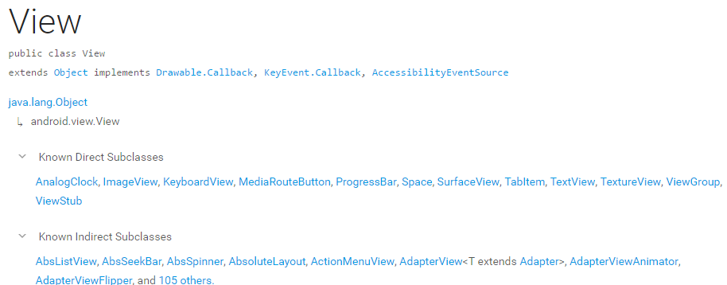
View Class
This class represents the basic building block for user interface components.
https://developer.android.com/reference/android/view/View.html

Slide 35
Object
View
ImageView
TextView
ViewGroup
Button
LinearLayout

Slide 36
Method of View Class
setBackgroundColor(int color)
setBackgroundDrawable(Drawable d)
setMinimumHeight(int minHeight)
setMinimumWidth(int minWidth)
setPadding(int left,int right,int top,int bottom)
setClickable(boolean c)
setFocusable(boolean f)
setOnClickListener(OnClickListener l)
setOnFocusChangeListener(OnFocusChangeListener l)
setLayoutParams(ViewGroup.LayoutParam l)

Slide 37
setOnClickListener

Slide 38
onClickListener object regonize whether the button is clicked or not.
We make a link between Button object and onClickListener object.

Slide 39
1
To make
onClickListener object separately
public class MainActivity extends Activity
{
public void onCreate(Bundle savedInstanceState)
{
super.onCreate(savedInstanceState);
setContentView(R.layout.activity_main);
Button mbutton = (Button)findViewById(R.id.btn_start).
mbutton.setOnClickListener(mClickListener);
}
Button.OnClickListener mClickListener = new View.OnClickListener(){
public void onClick(View v) {
//put your own code
}
}
};
}

Slide 40
1
To make
onClickListener object separately
public class MainActivity extends Activity
{
public void onCreate(Bundle savedInstanceState)
{
super.onCreate(savedInstanceState);
setContentView(R.layout.activity_main);
findViewById(R.id.btn_start).setOnClickListener(mClickListener);
}
Button.OnClickListener mClickListener = new View.OnClickListener(){
public void onClick(View v) {
//put your own code
}
}
};
}

Slide 41
2
To make
onClickListener object simultaneously
public class MainActivity extends Activity
{
public void onCreate(Bundle savedInstanceState)
{
super.onCreate(savedInstanceState);
setContentView(R.layout.activity_main);
findViewById(R.id.btn_start).setOnClickListener(
new Button.OnClickListener() {
public void onClick(View v) {
//put your own code
}
}
);
}
}

Slide 42
3
To implement
onClickListener interface
public class MainActivity extends Activity implements View.OnClickListener
{
public void onCreate(Bundle savedInstanceState)
{
super.onCreate(savedInstanceState);
setContentView(R.layout.activity_main);
Button btn_start =(Button)findViewById(R.id.btn_start);
btn_start.setOnClickListener(this);
}
public void onClick(View v) {
//put your own code
}
}

Slide 43
4
To use
onClick property of xml
<Button
android:id="@+id/btn_start"
android:layout_width="wrap_content"
android:layout_height="wrap_content"
android:onClick="btnStart"
android:text="Start"/>
public class MainActivity extends Activity
{
public void onCreate(Bundle savedInstanceState)
{
super.onCreate(savedInstanceState);
setContentView(R.layout.activity_main);
}
public void btnStart(View v) {
//put your own code
}
}

Slide 44
Toast class

Slide 45
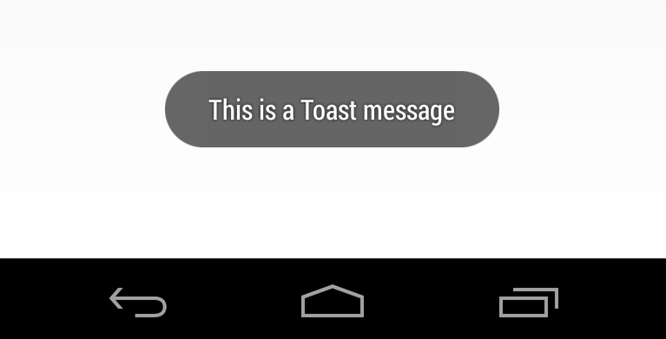

Slide 46

Method of Toast class
setView(View view)
setDuration(int duration) setText(CharSequence s)
setText(int resId)
setMargin(float horizontalMargin, float verticalMargin)
setGravity(int gravity, int xOffset, int yOffset)
makeText(Context context, int resId, int duration)
makeText
(Context context, CharSequence text, int duration)

Slide 47

Download skeleton
https://github.com/daehwa/world-friends-Uzbekistan-android/

Slide 48

Coding Time
Just raise your hand, Please
Or google ☺

